Slide 1
DevOps culture Organizing DevOps Teams and Architecture According to Conway’s Law
Notes:
Author: Ahmed Hosni
1

Slide 2
Agenda
Part 1:
IaC: The Big Picture
Create immutable infrastructure using Packer
Configuration Management using Ansible
Workshop
Part 2:
SRE Culture
Practical Alerting from Time-Series Data
Postmortem Culture Learning from Failure
SRE Emergency Procedures
Workshop
2

Slide 3
IaC: The Big Picture
Notes:
Author: Ahmed Hosni
3

Slide 4
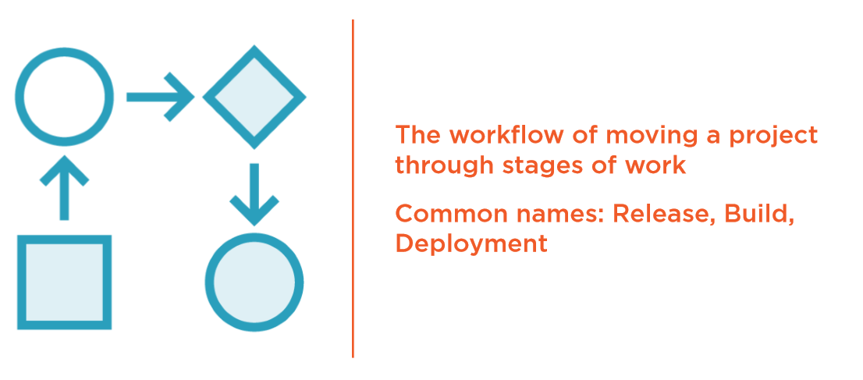
IaC: The Pipeline

Slide 5
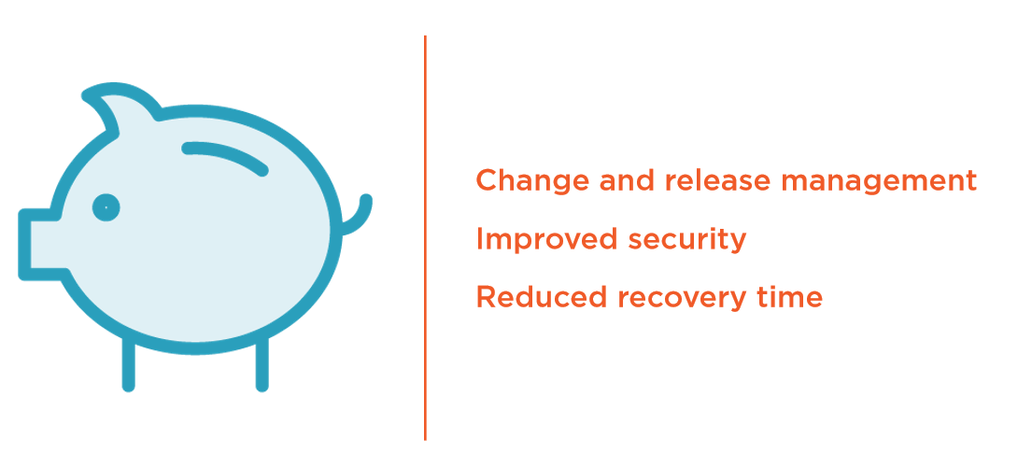
The Saving to Business and Customers

Slide 6
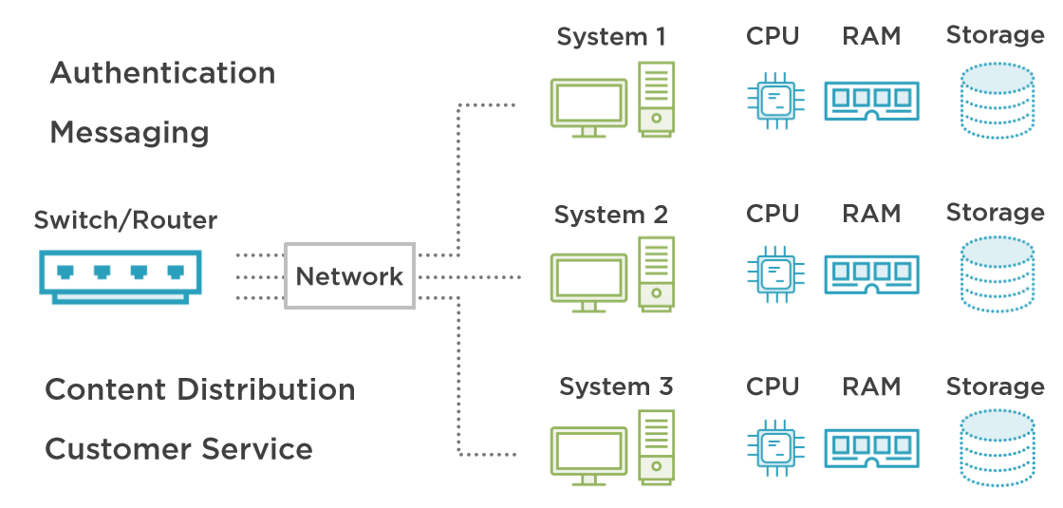
The Saving to Business and Customers

Slide 7
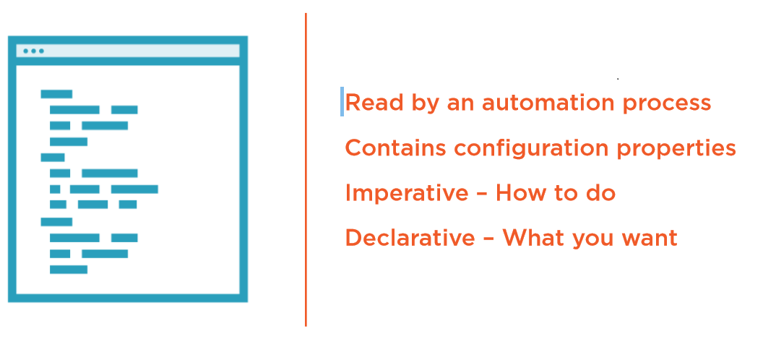
The Configuration

Slide 8
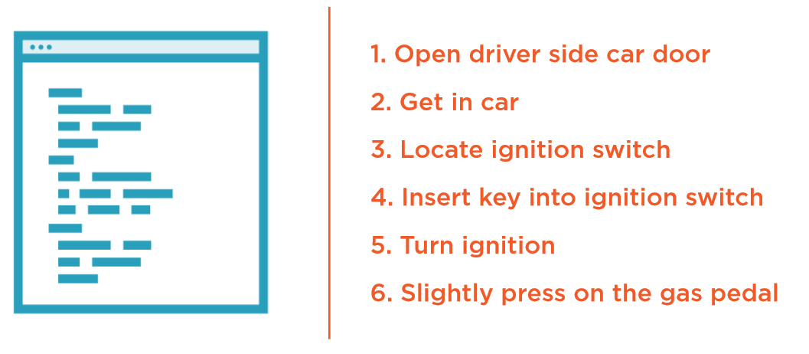
Imperative – Starting a Car

Slide 9
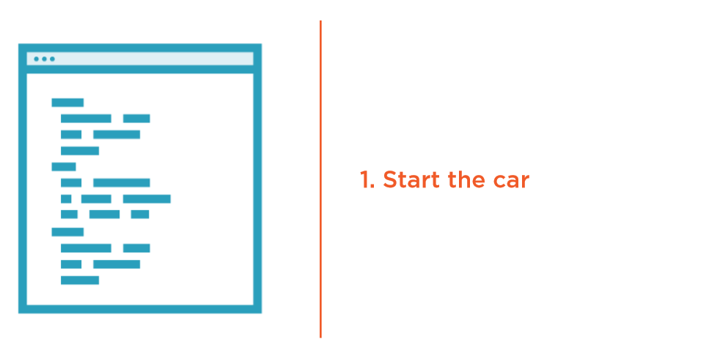
Declarative – Starting a Car

Slide 10
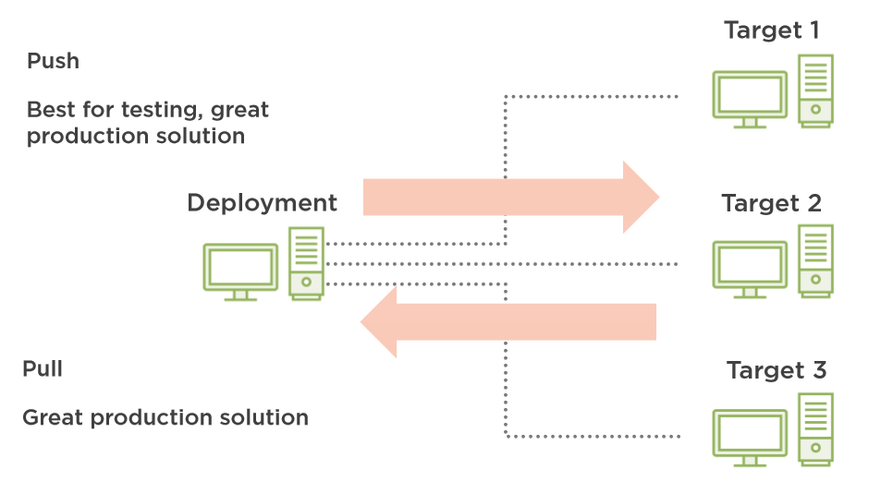
Push/Pull Target Delivery

Slide 11
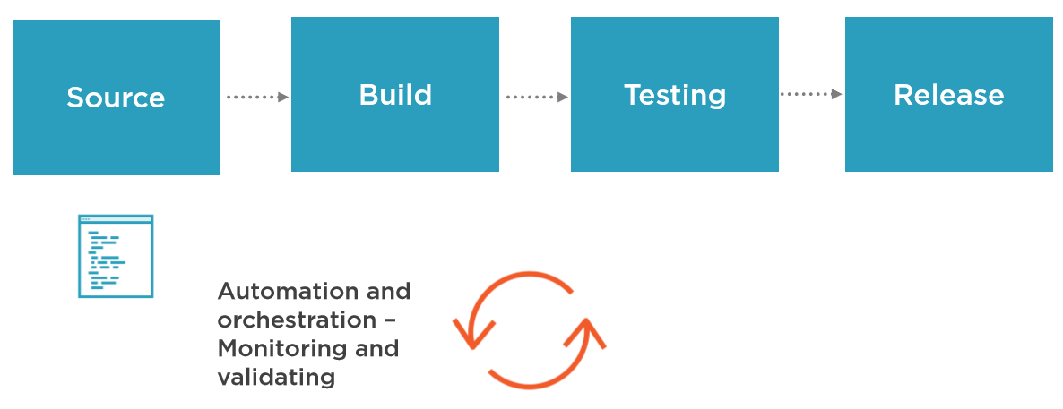
Push/Pull Target Delivery

Slide 12
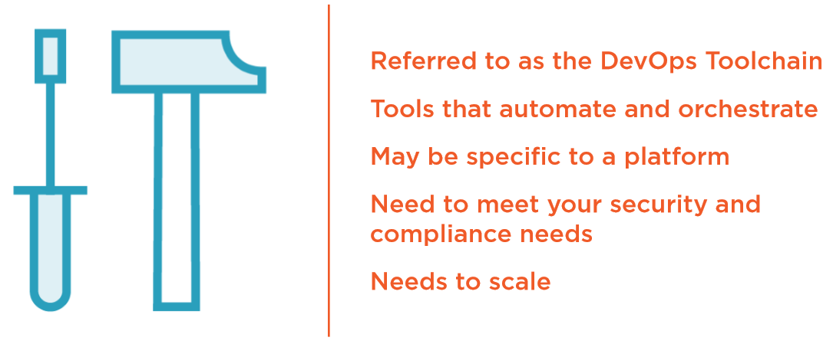
Continuous Configuration Automation (CCA) Tools

Slide 13
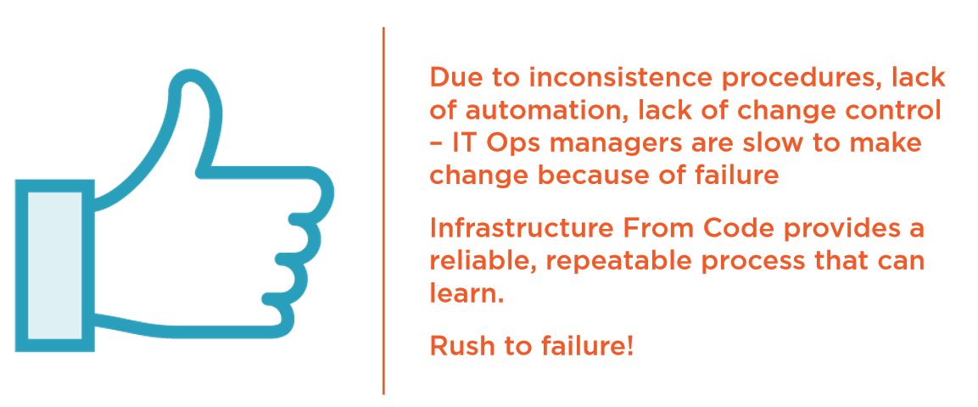
A New View of “Failure”

Slide 14
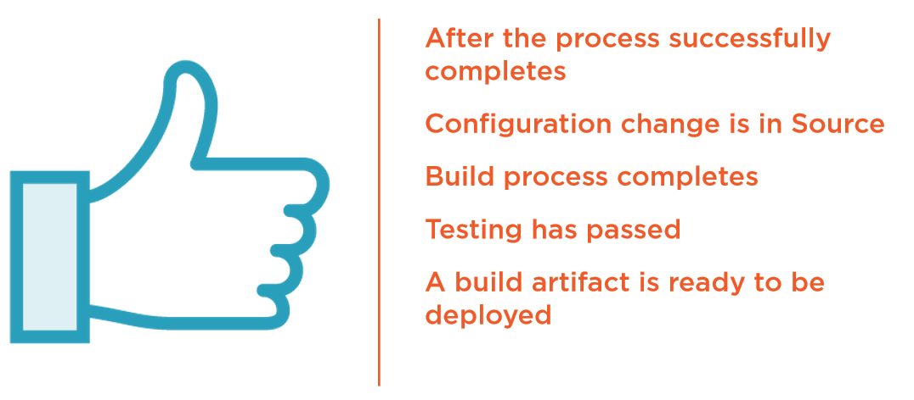
What Does Release Mean?

Slide 15


The Release Pipeline

Slide 16
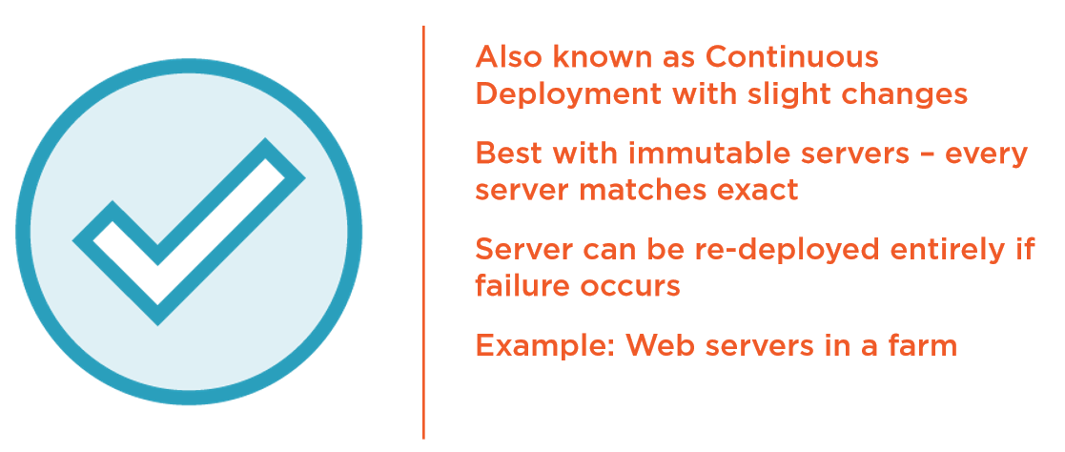
Continuous Delivery (CD)

Slide 17
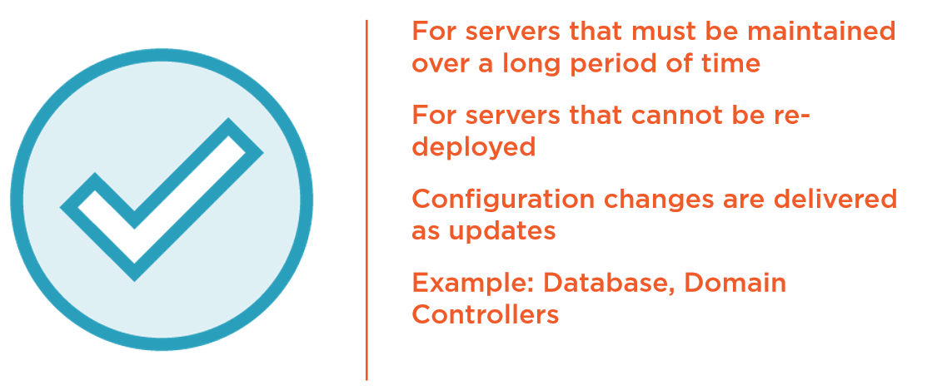
Incremental Deployment

Slide 18
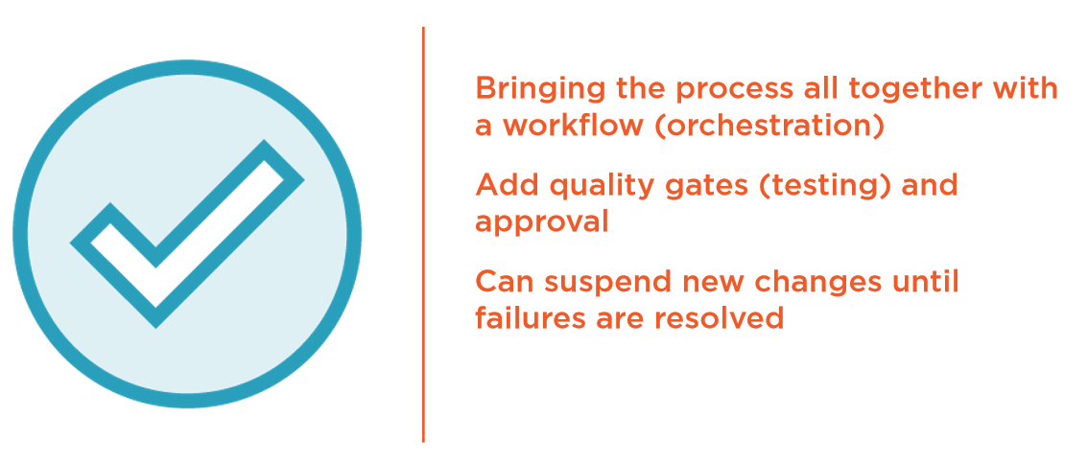
Continuous Integration

Slide 19
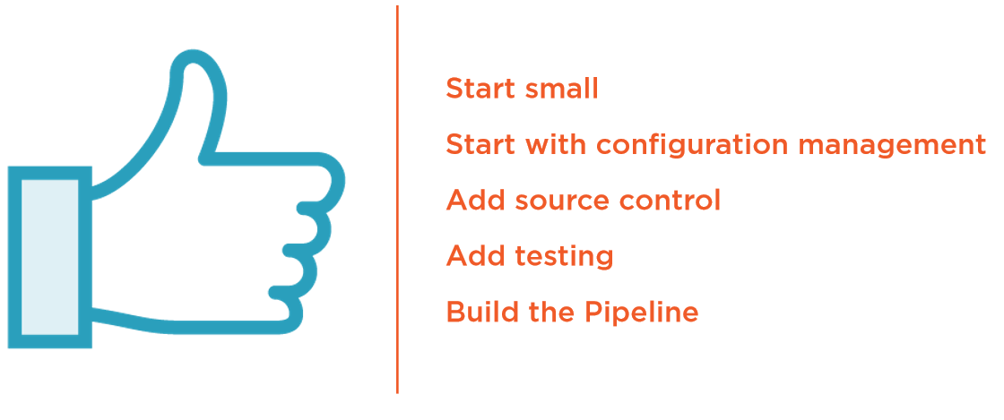
Getting Started – Infrastructure as Code

Slide 20
Create immutable infrastructure using Hashicorp Packer
Notes:
Author: Ahmed Hosni
20

Slide 21
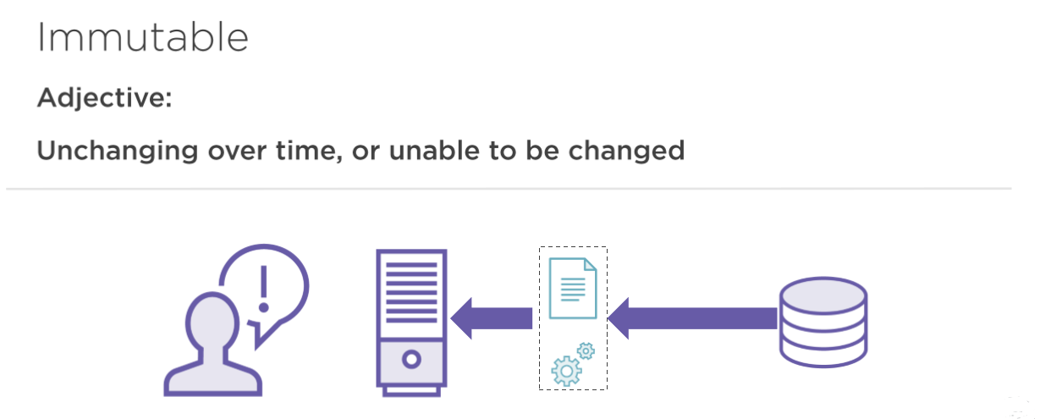
Immutable Infrastructure

Slide 22
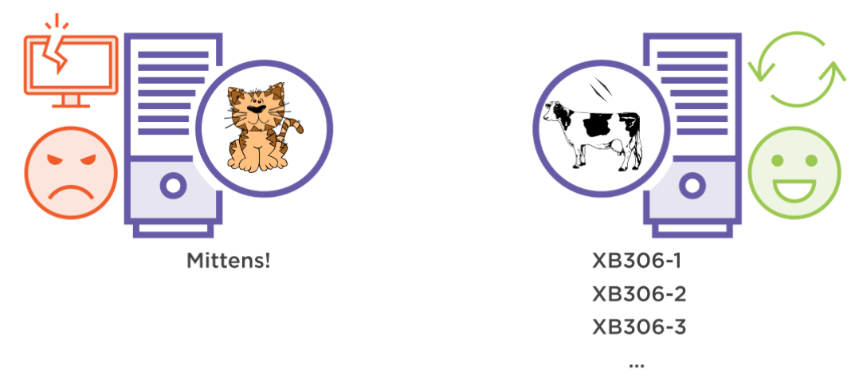
Pets and Cattle

Slide 23
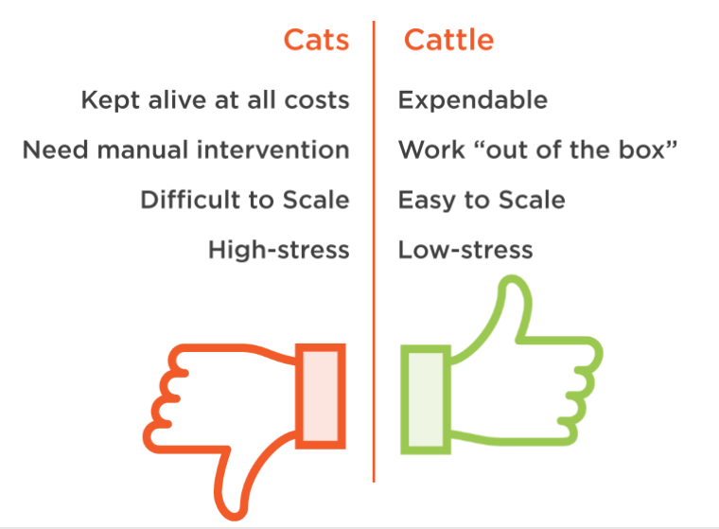
Pets and Cattle

Slide 24
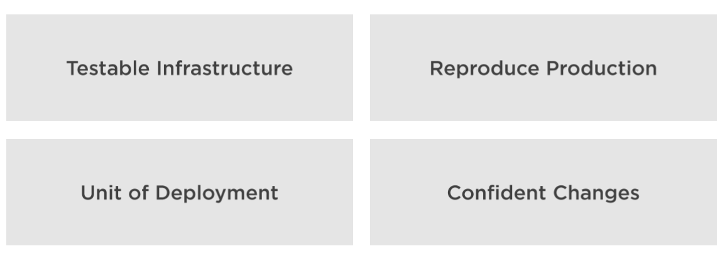
Other benefits

Slide 25


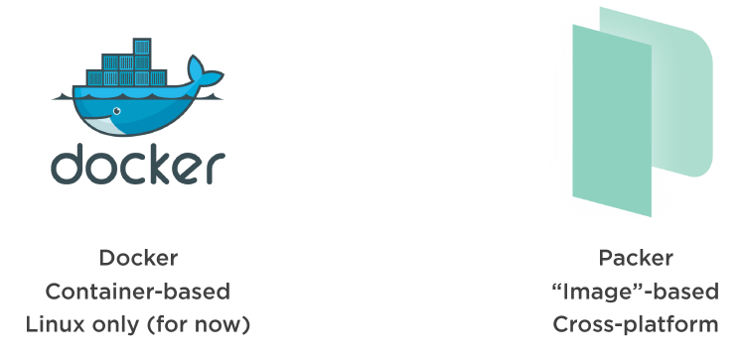
When to use it? How?

Slide 26
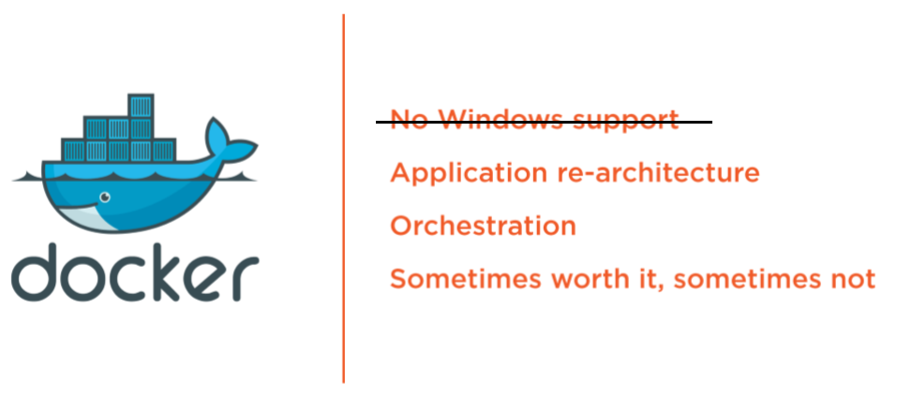
Docker?

Slide 27
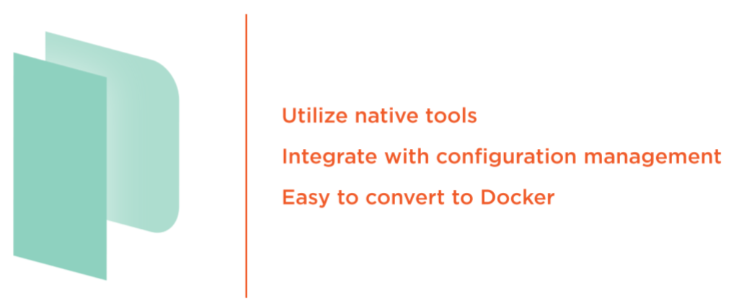
Packer!

Slide 28
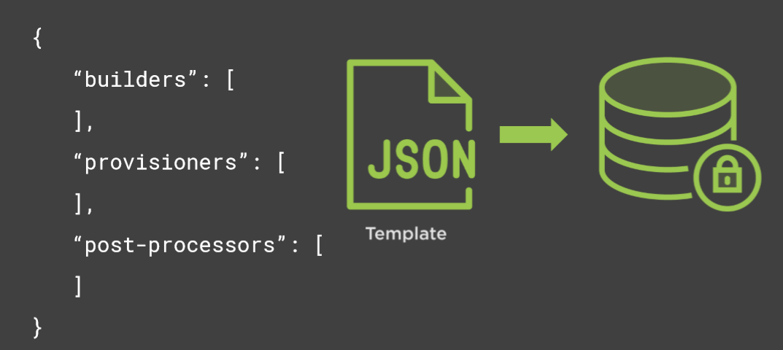
A Packer Template

Slide 29
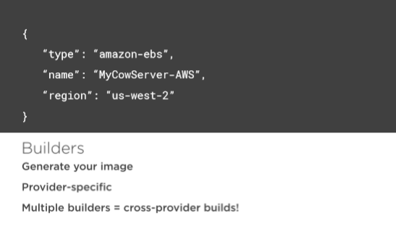
A Packer Template

Slide 30
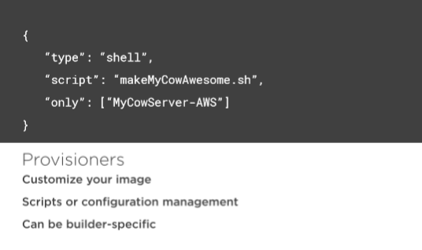
A Packer Template

Slide 31
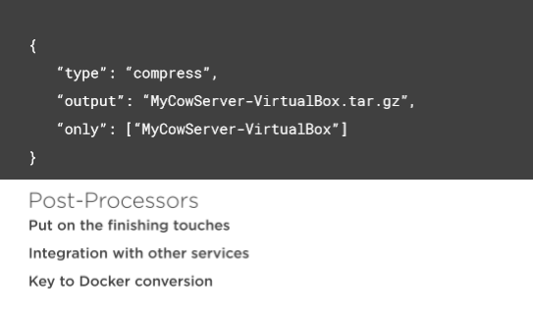
A Packer Template

Slide 32
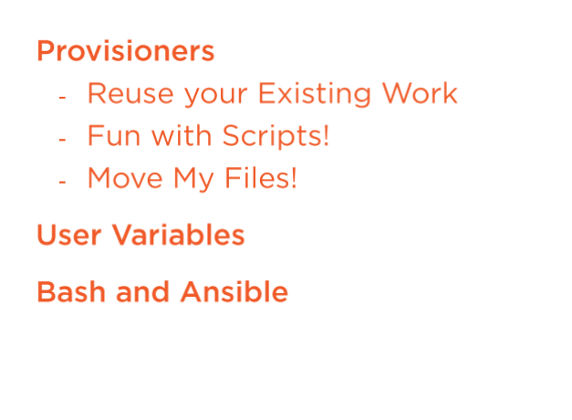
Provisioners

Slide 33
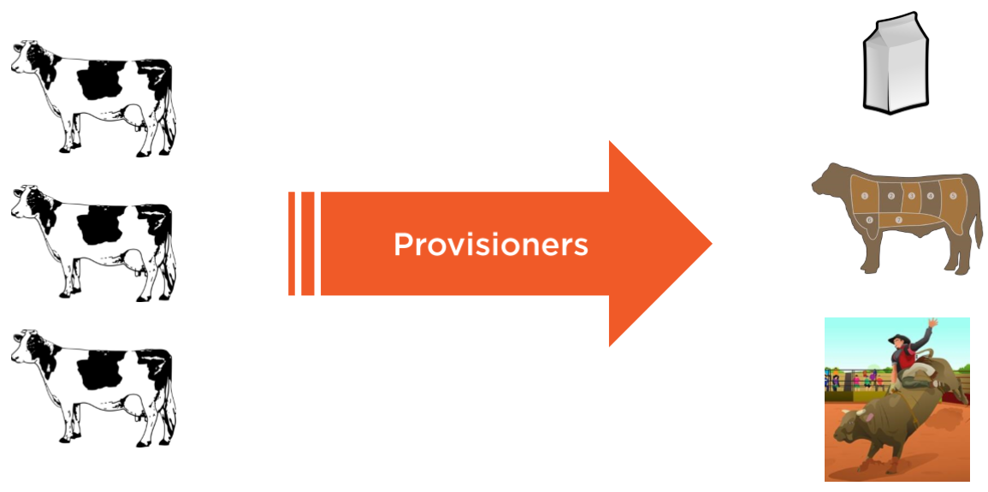
Provisioners

Slide 34
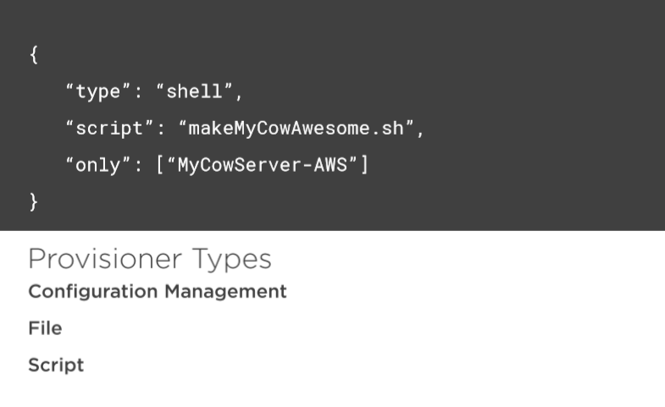
Provisioners

Slide 35
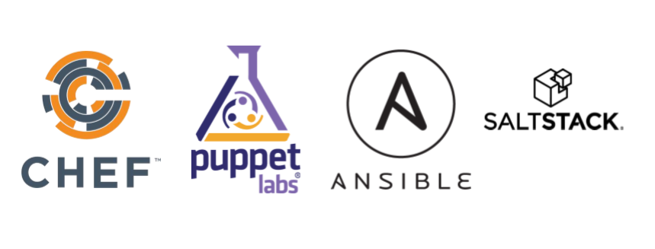
Configuration Management Provisioners

Slide 36
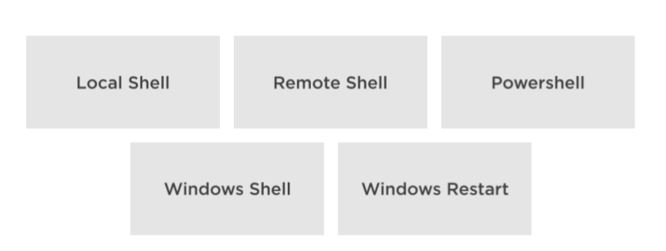
Script Provisioners

Slide 37
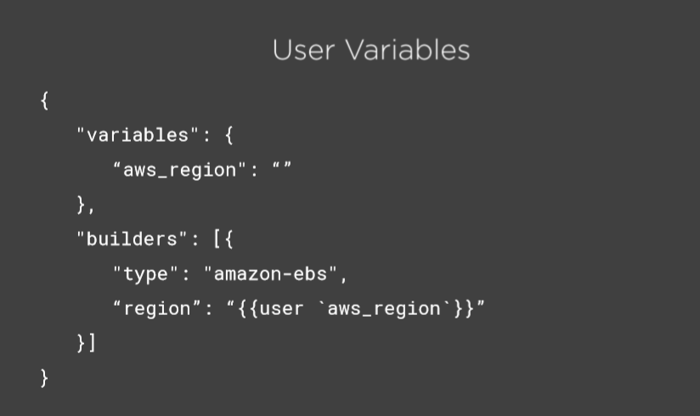
Variables

Slide 38
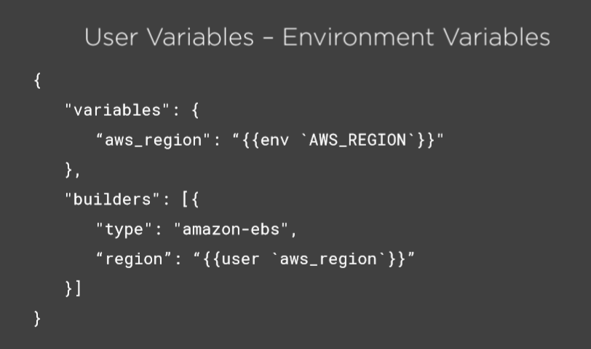
Variables

Slide 39
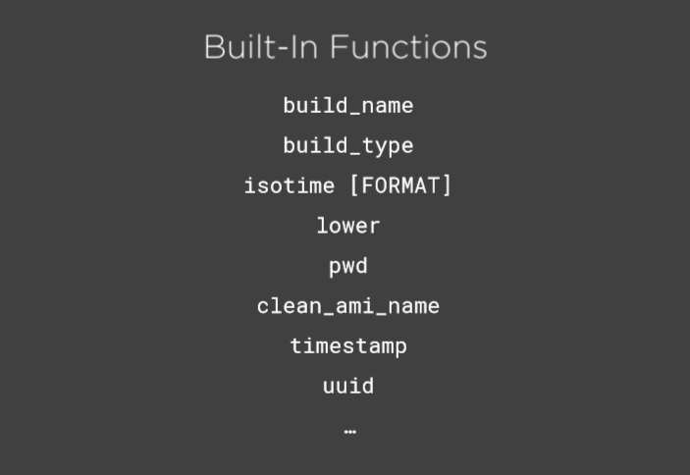

Slide 40
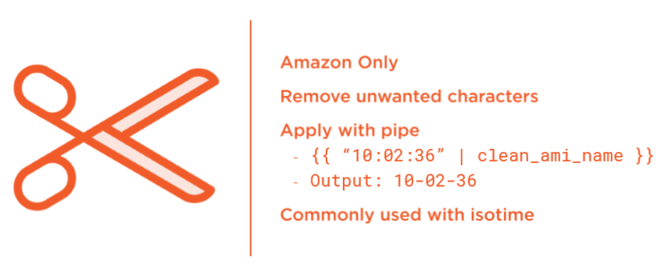
clean-ami-name

Slide 41
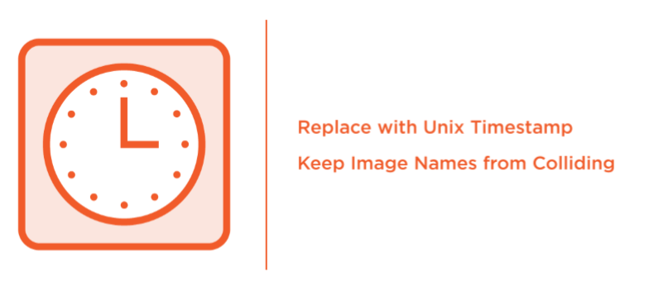
Timestamp

Slide 42
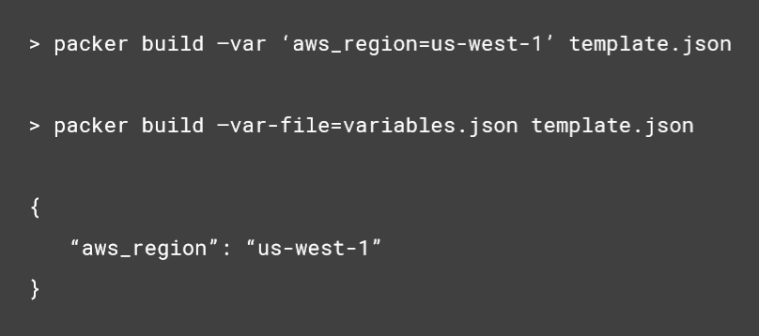
User Variables - Setting

Slide 43

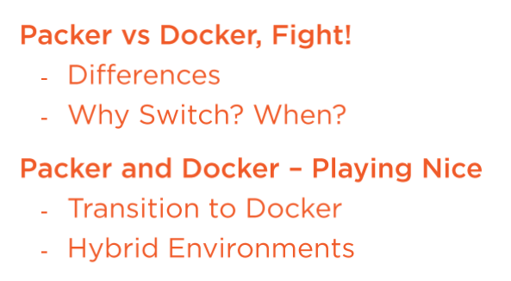
Transitioning from Packer to Docker

Slide 44
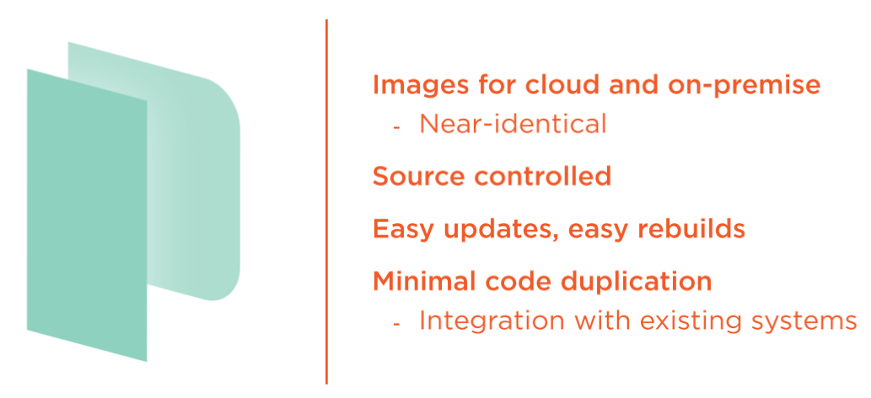
Packer - What We've Got so far

Slide 45
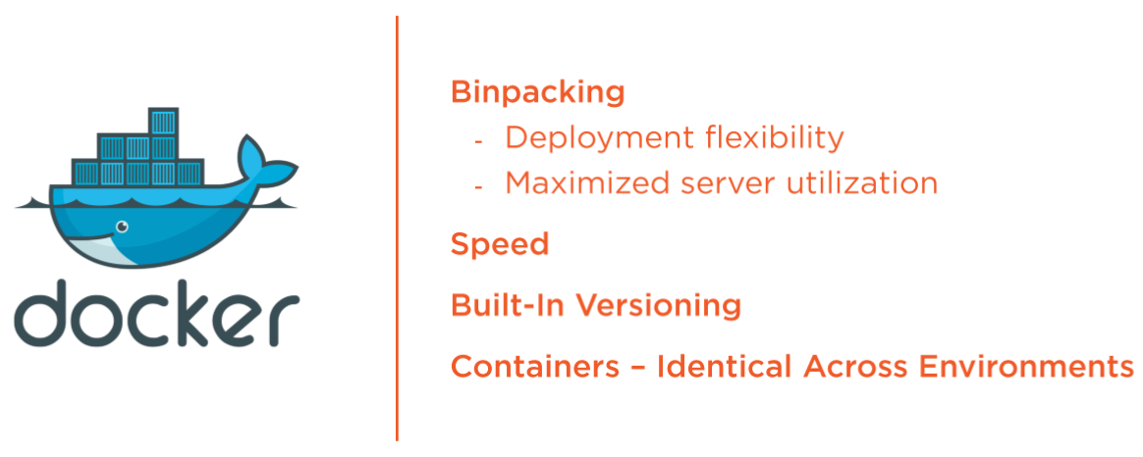
Docker - What Else Do you Get?

Slide 46
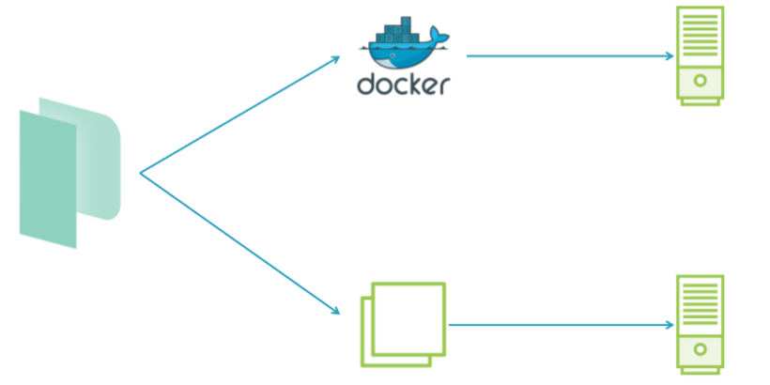
Packer - Hybrid Builds

Slide 47
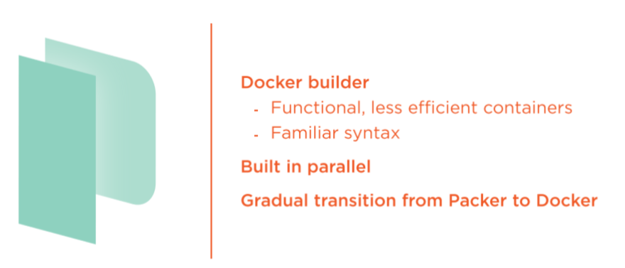
Packer - Hybrid Builds

Slide 48

DEMO
- Install Packer
- Command Line Options
- Basic Packer Template:
- Ubuntu 18.04 LTS
- Your First Cow Server!

Slide 49
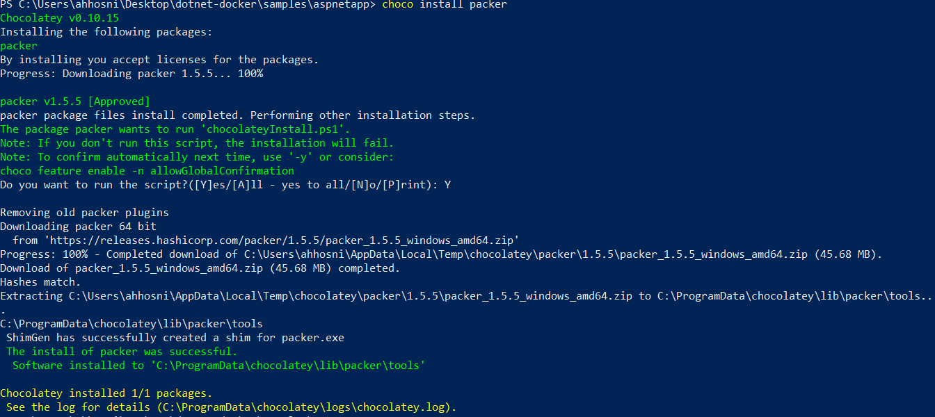
Install > choco install packer
Notes:
https://chocolatey.org/packages/packer

Slide 50
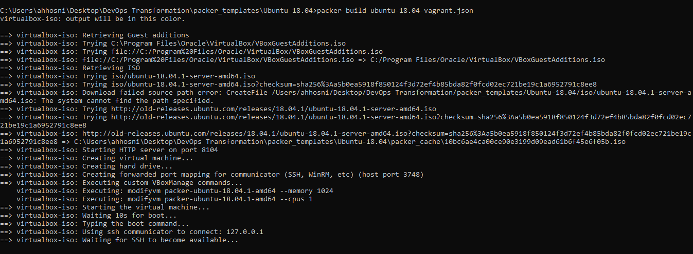
Basic Packer Template

Slide 51
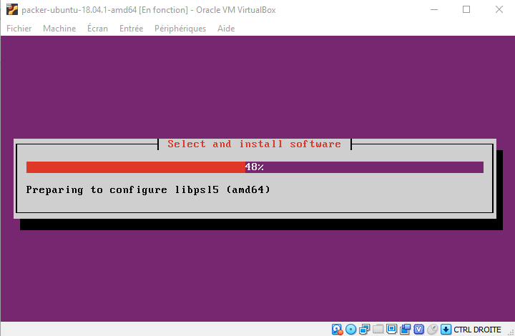
Basic Packer Template

Slide 52
Configuration Management using Ansible

Slide 53
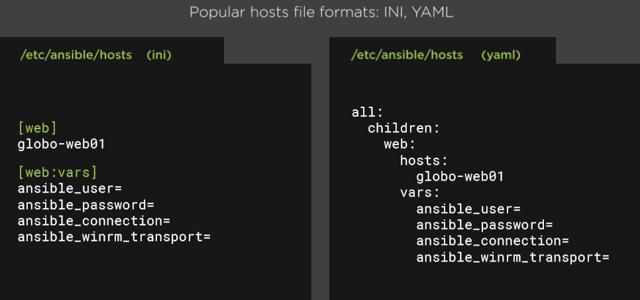
Implementing Ansible Inventory

Slide 54
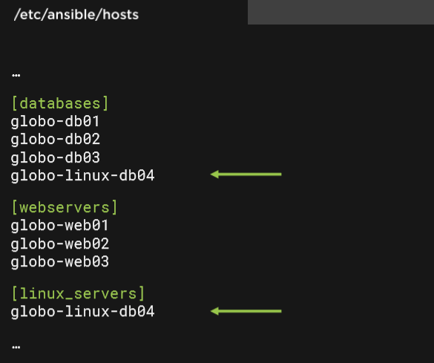
Ansible Groups

Slide 55
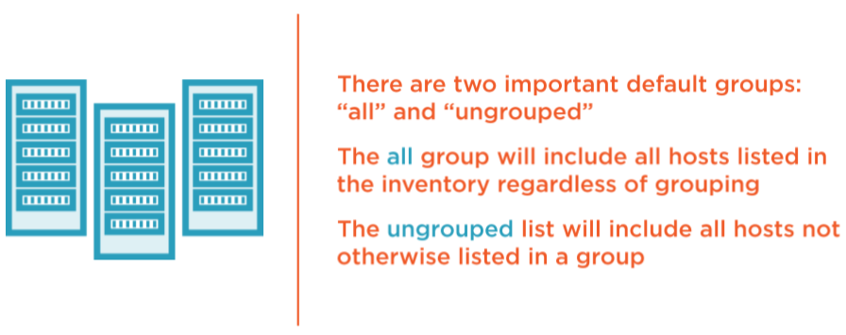
Ansible Default Groups: All, Ungrouped

Slide 56
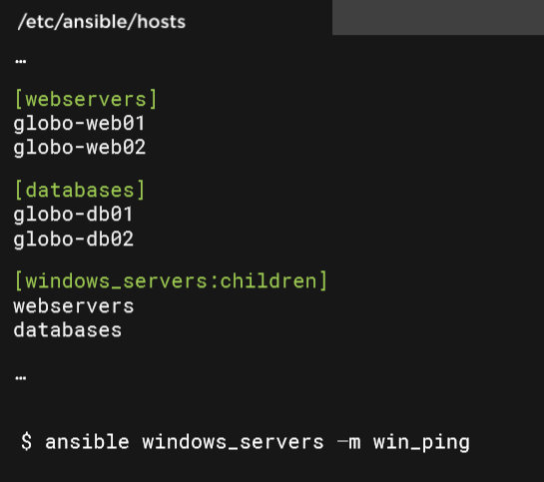
Nested Groups

Slide 57
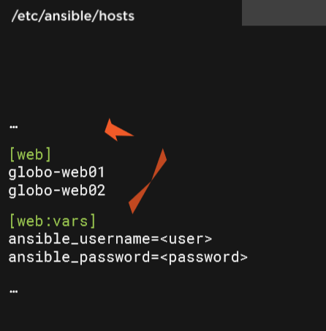
Ansible Variables

Slide 58

Overriding variables

Slide 59

Nested Group Variables

Slide 60
Writing Ansible playbooks
Playbooks are essentially sets of instructions (plays) that you send to run on a single target or groups of targets (hosts).
For this example, the target host will be a RHEL/CentOS 7 base install.
There will be a web server installed (NGINX) and then an index.html file will be created in the default webroot.
After the install and file tasks are completed the service will be started.

Slide 61

Writing Ansible playbooks
Playbooks start with the YAML three dashes (---) followed by:
Name: good for keeping the Playbooks readable
Hosts: identifies the target for Ansible to run against
Become statements: true statement is included here to ensure nginx installs without a problem (it's not always required)

Slide 62

Writing Ansible playbooks
The state:
Present statement lets Ansible check the state on the target first before performing any further action.
In both cases if the repo or package is already present, Ansible knows it doesn't have to do any more for this task and continues.

Slide 63


Writing Ansible playbooks
Insert the index page in the default NgInx location
The last thing the Playbook will do is make sure that the nginx service has been started (and if not, start it).

Slide 64

Writing Ansible playbooks

Slide 65

Ansible Comes with Many Modules

Slide 66

Ansible Comes with Many Modules

Slide 67

Modules Are Idempotent

Slide 68

The gather_facts Module

Slide 69

Let's Talk About Playbooks

Slide 70

Playbooks are often stored in SCM

Slide 71

The Play

Slide 72

Hosts

Slide 73

Variables

Slide 74

Tasks

Slide 75

Tasks

Slide 76

State of Things

Slide 77

Writing Ansible roles

Slide 78

Ansible Role Folder Structure

Slide 79

The Meta Folder

Slide 80

The Task Folder

Slide 81

Other Ansible Role Folders

Slide 82

Ansible Templates with Jinja2

Slide 83
Workshop Ansible 101
Notes:
https://github.com/m2i-training/ansible-101

Slide 84


Setting the Ansible with Docker

Slide 85

Create a Docker container embedding Ansible

Slide 86
Bootstrap Ansible LAB
To bootstrap this lab environment, execute init script, it will perform the following tasks:
Delete previous 3 containers Debian, Ubuntu et Centos
Create an RSA key allowing Ansible connection through SSH
Starting 3 instances Docker Debian, Docker Ubuntu, and Docker Centos
Ssh key injection in each Docker instance using ssh-copy-id (password will be ask: toor)
Ansible hosts inventory creation

Slide 87

Bootstrap Ansible LAB

Slide 88

Check connectivity
We check that all the nodes are reachable by Ansible using the following command:
> docker run -it --rm -v `pwd`/hosts:/etc/ansible/hosts -v `pwd`/id_rsa:/root/.ssh/id_rsa itwars/ansible-cli all -m ping
Here is some details about the params:
Ansible needs a hosts inventory file (generated by the init script).
The Ansible container needs the private key to connect to the nodes (generated by the init script).
Ansible is invoked with the params "all -m ping": we apply the ping module to all nodes

Slide 89

Installing a service with Ansible
Let's ask Ansbile to install Nginx service on the "debian" node:
> docker run -it --rm -v `pwd`/hosts:/etc/ansible/hosts -v `pwd`/id_rsa:/root/.ssh/id_rsa itwars/ansible-cli debian -m apt -a "name=nginx state=present"

Slide 90

Starting a service with Ansible
Let's ask Ansbile to start Nginx service on the "debian" node:
> docker run -it --rm -v `pwd`/hosts:/etc/ansible/hosts -v `pwd`/id_rsa:/root/.ssh/id_rsa itwars/ansible-cli debian -m service -a "name=nginx state=started"

Slide 91

Retrieve the setup of a node with Ansible
> docker run -it --rm -v `pwd`/hosts:/etc/ansible/hosts -v `pwd`/id_rsa:/root/.ssh/id_rsa itwars/ansible-cli debian -m setup

Slide 92
Demo using Ansible Role

Slide 93

Create an Ansible Role

Slide 94

Create an Ansible Role
Begin by creating a new role using ansible-galaxy.
We will use the --offline option so we do not query the galaxy API
Run: ansible-galaxy init axefinance-role --offline
Notes:
https://galaxy.ansible.com/docs/contributing/creating_role.html

Slide 95

Ansible Galaxy
Notes:
Try:
> ansible-galaxy install geerlingguy.jenkins

Slide 96
SRE Culture

Slide 97

Not that far away maybe in a company just like yours…

Slide 98

98

Slide 99

What changed?

Slide 100


Principles of SRE are what set SRE apart
Notes:
https://www.youtube.com/watch?v=c-w_GYvi0eA&feature=youtu.be

Slide 101

SLO and Error Budgets: Tools for Shared Responsibility

Slide 102

SLO and Error Budgets: Tools for Shared Responsibility

Slide 103

Toil: Name For a Problem We’ve All Felt

Slide 104

Toil vs. Engineering Work

Slide 105

Excessive Toil Prevents Fixing the System

Slide 106

Toil is a naturally occurring force

Slide 107

Where to start?
Notes:
Why focus on reducing toil?
Lots of value independent of “SRE”
Your people are you most expensive assets … stay out of their way!

Slide 108

Your people are expensive stay out of their way!

Slide 109



Ticket queues: Interruptions, waiting, and toil

Slide 110

Super easy to get started

Slide 111

Where to focus

Slide 112

Self-Service Operations Design Pattern (in a nutshell)

Slide 113

Self-Service is ultimately about user experience

Slide 114

“Do it, do it again, then do it again.”

Slide 115

“I could fix it, but I can’t get to it.”

Slide 116

“I’m an expert, I don’t read the wiki.”

Slide 117

“Known issue… doesn’t get permanent fix”

Slide 118

Avoid culture of heros

Slide 119


Recap: Make Tomorrow Better Than Today

Slide 120
Case study

Slide 121

Real-World DevOps Experiences from a 165-year Old Bank Standard Chartered Bank

Slide 122

Real-World DevOps Experiences from a 165-year Old Bank Standard Chartered Bank

Slide 123
Practical Alerting from Time-Series Data

Slide 124

“The Happy Developer”

Slide 125

Disaster Strikes

Slide 126

Logging vs Monitoring

Slide 127


Slide 128

Why Monitoring?

Slide 129

What to monitor?

Slide 130

We have Storage problem!

Slide 131

Time Series - Database

Slide 132

Time Series - Data format

Slide 133
DB-Engines Ranking of Time Series DBMS
Notes:
https://db-engines.com/en/ranking/time+series+dbms

Slide 134

Instrumenting your own code!

Slide 135

Prometheus Overview

Slide 136

Prometheus Components

Slide 137

Prometheus Components

Slide 138

Pull vs Push

Slide 139

Exporters

Slide 140

Common exporters

Slide 141

Grafana

Slide 142

Alerting Configuration

Slide 143

Alerting Configuration

Slide 144

Alerting Configuration

Slide 145

Alerting Configuration

Slide 146

Instrumenting your own code!

Slide 147

Prometheus Client Libaries SpringBoot Example

Slide 148
Workshop Monitoring stack with Grafana and InfluxDB on K8S

Slide 149
Setup the monitoring stack
InfluxDB is a time series database optimized for high-availability storage and rapid retrieval of time series data.
To visualize the collected metrics, we'll use Grafana.
We will use Helm charts to install both the InfluxDB and Grafana packages. To use Helm, we first need the Helm client itself:
$ choco install kubernetes-helm

Slide 150
Setup the monitoring stack
The next step is to use Helm to install charts for Grafana and InfluxDB:
$ helm repo add stable https://kubernetes-charts.storage.googleapis.com/
$ helm install stable/influxdb --name-template influxdb
$ helm install stable/grafana --name-template grafana

Slide 151
Setup the monitoring stack
Change the grafana service type from ClusterIp to NodePort:
$ kubectl delete svc grafana
$ kubectl expose deployment grafana --type=NodePort
Retrieve the service url:
$ minikube service grafana
Fetch the Grafana dashboard credentials:
$ kubectl get secret grafana -o jsonpath='{.data.admin-password}' | base64 --decode

Slide 152

Grafana dashboard

Slide 153
Postmortem Culture Learning from Failure

Slide 154

Workarounds…

Slide 155

The goals of a postmortem are to understand all contributing root causes, document the incident for future reference and pattern discovery, and enact effective preventative actions to reduce the likelihood or impact of recurrence.

Slide 156
What is postmortem?
A postmortem is a written record of an incident that describes:
The incident’s impact.
The actions taken to mitigate or resolve the incident.
The incident’s causes.
Follow-up actions taken to prevent the incident from happening again.

Slide 157
Postmortem process overview
For postmortems to be effective, the process has to make it easy for teams to identify causes and fix them..
Postmortems should not be restricted/limited to only technical issues (outages, technical incidents, failures), because otherwise we miss a lot of valuable information from other areas that are helpful for continuous improvement.
Template: https://github.com/dastergon/postmortem-templates/blob/master/templates/postmortem-template-srebook.md

Slide 158
Postmortem process overview
They should also include situational issues we might encounter like:
Communication problems.
Conflicts.
Anything you can learn from.
It is VERY IMPORTANT when writing them to:
Use blameless language.
Be annonymous without fingerpointing.
Be constructive.

Slide 159
Which information should a postmortem contain?
An overview to provide context.
A description of the problem (what happened?).
The root cause (Why it happened?).
A resolution (How we solved the issue).
A lesson learned.

Slide 160
Which information should a postmortem contain?
Some other extra information that could be useful to include:
Screenshots.
Tickets.
Charts.
Timelines.
External feedback.

Slide 161
Tooling requirements
Incident tracking
Chat room
Video chat
Alerting system
Documentation tool
Statuspage
Notes:
Incident tracking: every incident is tracked as an issue, with a follow-up issue created to track the completion of postmortems.
Chat room: a real-time text communication channel that is fundamental to diagnosing and resolving the incident as a team.
Video chat: for many incidents, team video chat tools can help to discuss and agree on approaches.
Alerting system: a tool that manages on-call rotations and escalations.
Documentation tool: use a tool for incident state documents and sharing postmortem via blogs.
Statuspage: communicating status with both internal stakeholders and customers through Statuspage helps keep everyone in the loop.

Slide 162

Public postmortems?
https://about.gitlab.com/blog/2017/02/10/postmortem-of-database-outage-of-january-31/
Notes:
More postmortems:
A bad config (router rule) caused all of their edge routers to crash, taking down all of Cloudflare:
https://blog.cloudflare.com/todays-outage-post-mortem-82515/
A bad config took down both Facebook and Instagram:
https://blog.thousandeyes.com/facebook-outage-deep-dive/
A bad config took down Azure storage:
https://azure.microsoft.com/en-us/blog/update-on-azure-storage-service-interruption/
*

Slide 163

Replay postmortem scenarios as training

Slide 164
SRE Emergency Procedures

Slide 165

Context: Launching new features vs reliability

Slide 166

Context: Launching new features vs reliability

Slide 167

Path towards high availability

Slide 168

Quiz: I want my service availability to be … ?

Slide 169

Right answer

Slide 170

Deciding on right availability target answer

Slide 171

Service Level Indicators

Slide 172


Service Level Objectives (SLOs)

Slide 173

Expected downtime

Slide 174

Error Budget

Slide 175

Life of an incident

Slide 176

Life of an incident

Slide 177

Life of an incident

Slide 178

Life of an incident

Slide 179

Life of an incident

Slide 180

Recap

Slide 181
Questions?

